Slide 1
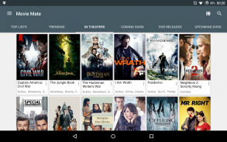
MovieMate: An Automated Movie Ticket Booking System
Introducing an innovative automated system that streamlines the movie ticket booking process, allowing users to specify seating preferences and movie details for a hassle-free experience.

Slide 2
Group 06 - Team Members
Khushi Kalathiya - Database Developer Nishi Mewada - Frontend Developer Nourelislam Zouar - Tester SivaSaketh Bezawada - Backend Developer Yash Patil - Integration Engineer All team members have collectively contributed to the creation of all documents, diagrams, and slides.

Slide 3




System Description
Simplify ticket purchase
Automated booking
Booking movie tickets is often a time-consuming and frustrating experience, especially for busy individuals.
The system handles the entire booking process automatically, reducing user effort and ensuring seamless ticket reservations once booking opens for a movie.
User preferences
Users can specify their preferred seating choices and provide relevant movie details to tailor the booking experience.
Payment integration
After successfully blocking tickets, the system sends a secure payment link to users for easy and convenient transactions through email provided while registering the account.
MovieMate aims to revolutionize the movie-going experience by providing an automated and user-friendly platform for effortless ticket booking, catering to the needs of busy individuals.

Slide 4
Scope and Goal
Streamline Ticket Purchasing
Develop an automated movie ticket booking system tailored to streamline the ticket purchasing process for users with busy schedules.
Customizable Preferences
Enable users to customize their seating preferences and input movie-related information to enhance their booking experience.
Automated Booking
Implement automated booking functionality to seamlessly reserve tickets for users, eliminating the need for manual intervention in case of high demands.
Notification System
Incorporate notification mechanisms to alert users with payment url once tickets are blocked and ready to book.
User-Friendly Interface
Design user-friendly interfaces for inputting preferences and viewing booking details, ensuring an intuitive and accessible experience for all users.

Slide 5
Main User Stories
Fill Client Form
Allow users to input personal and contact details for booking purposes.
Specify Theater and Movie Details
Enable users to select preferred theater, movie title, date, and showtime.
Choose Preferred Seats
Allow users to specify seating preferences like aisle, middle, or front row seats.
Secure Payment Process
Securely complete the payment process for their selected tickets.
Receive Payment Link
Send a payment link via email or text message for confirmed bookings.

Slide 6
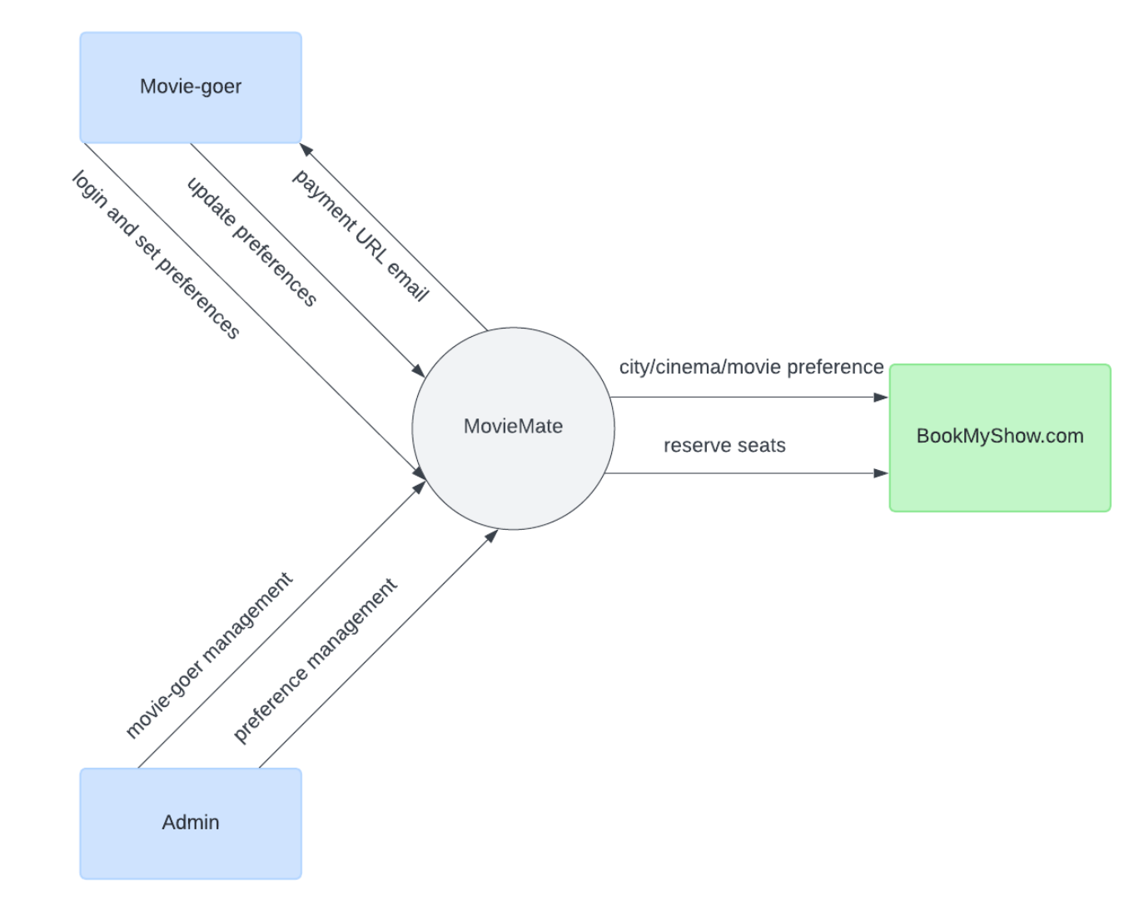
Context Diagram
Illustrates the system's scope and its interactions with external entities.

Slide 7
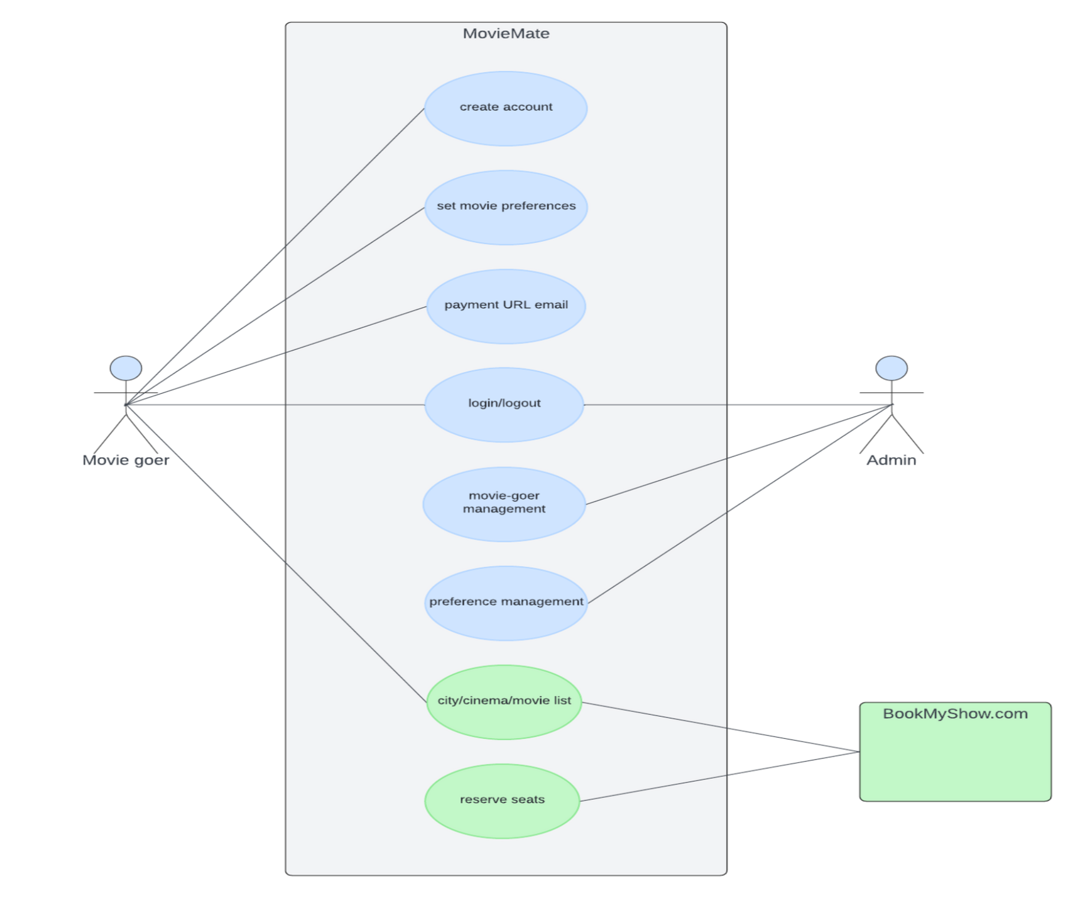
Usecase Diagram
The usecase diagram provides a basic flow of events through the system to achieve specific goals

Slide 8
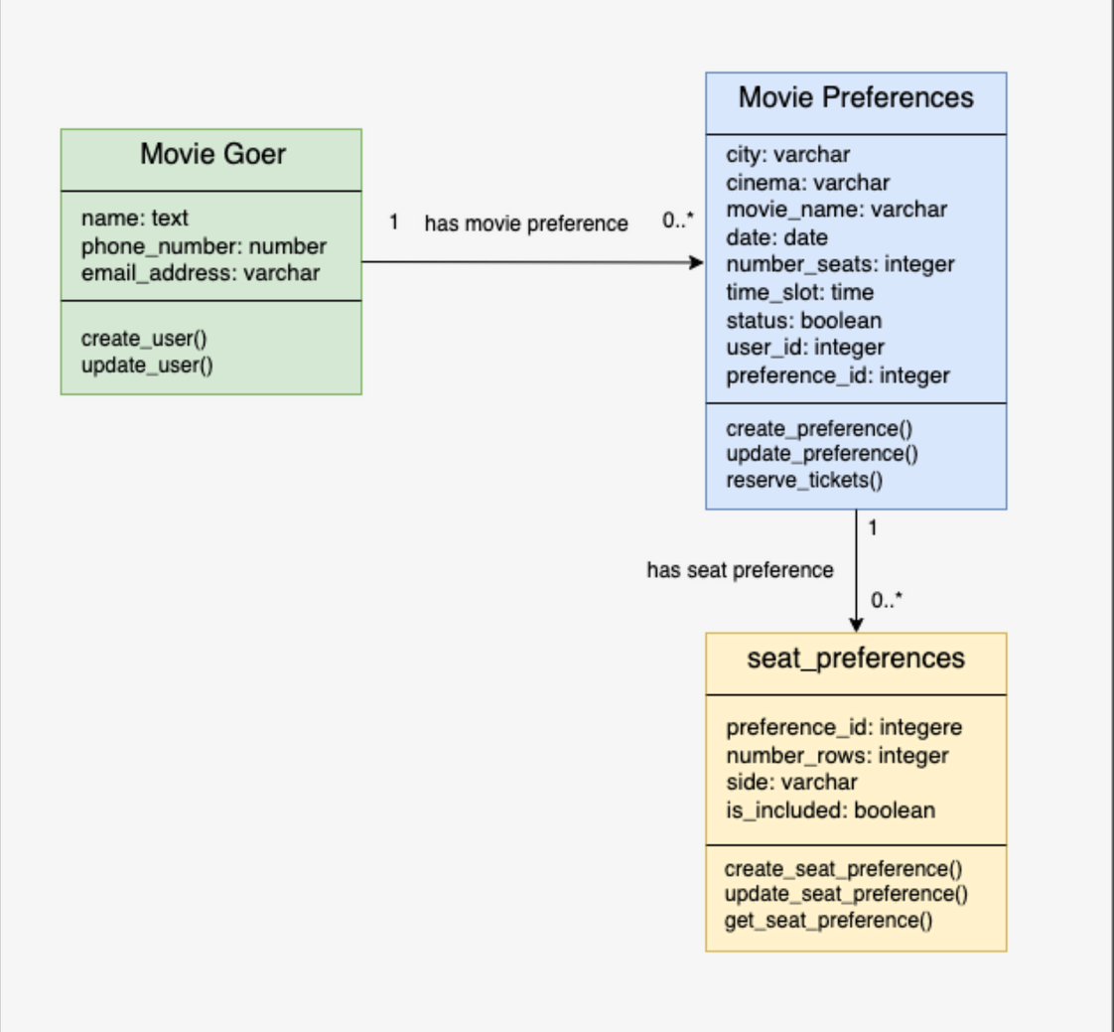
Database Diagram
The database diagram provides an overview of the relationships and structure within the database in a visual format

Slide 9
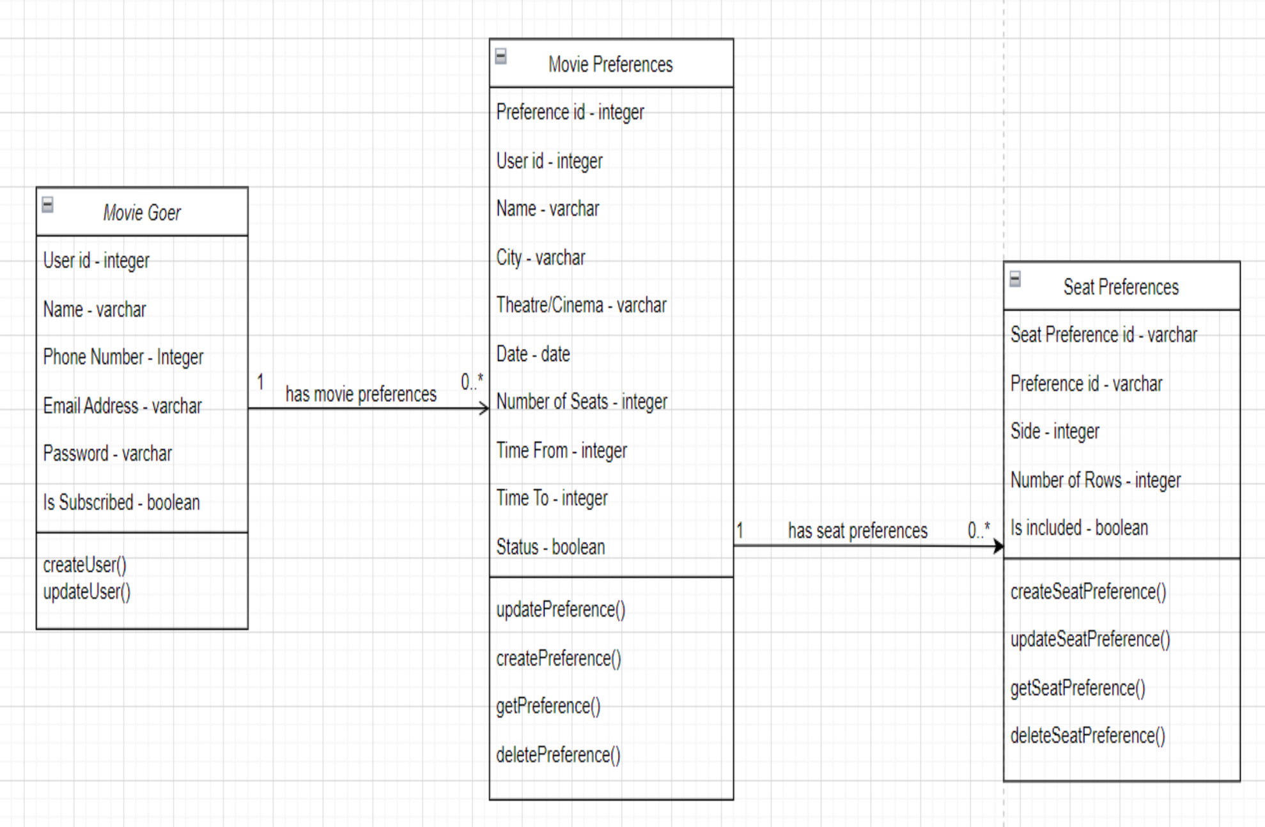
Class Diagram
This class diagram provides a visual representation of a system's classes and their relationships

Slide 10
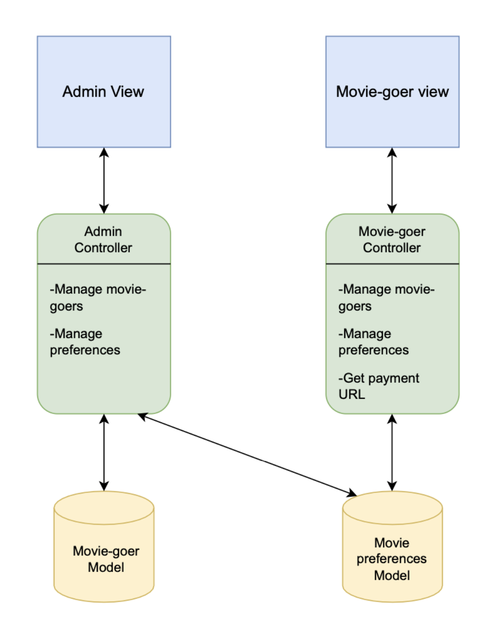
MovieMate Model View Controller Diagram
The diagram portrays the separation of an application into three core components: the model, the view, and the controller

Slide 11
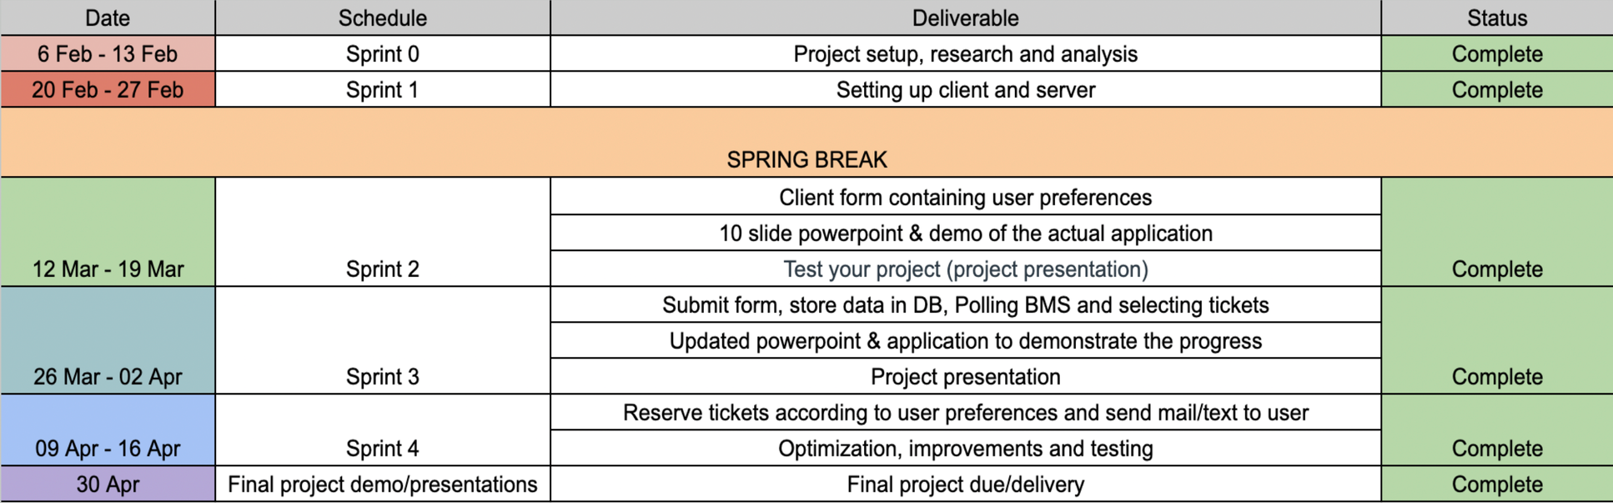
Sprint Plan

Slide 12
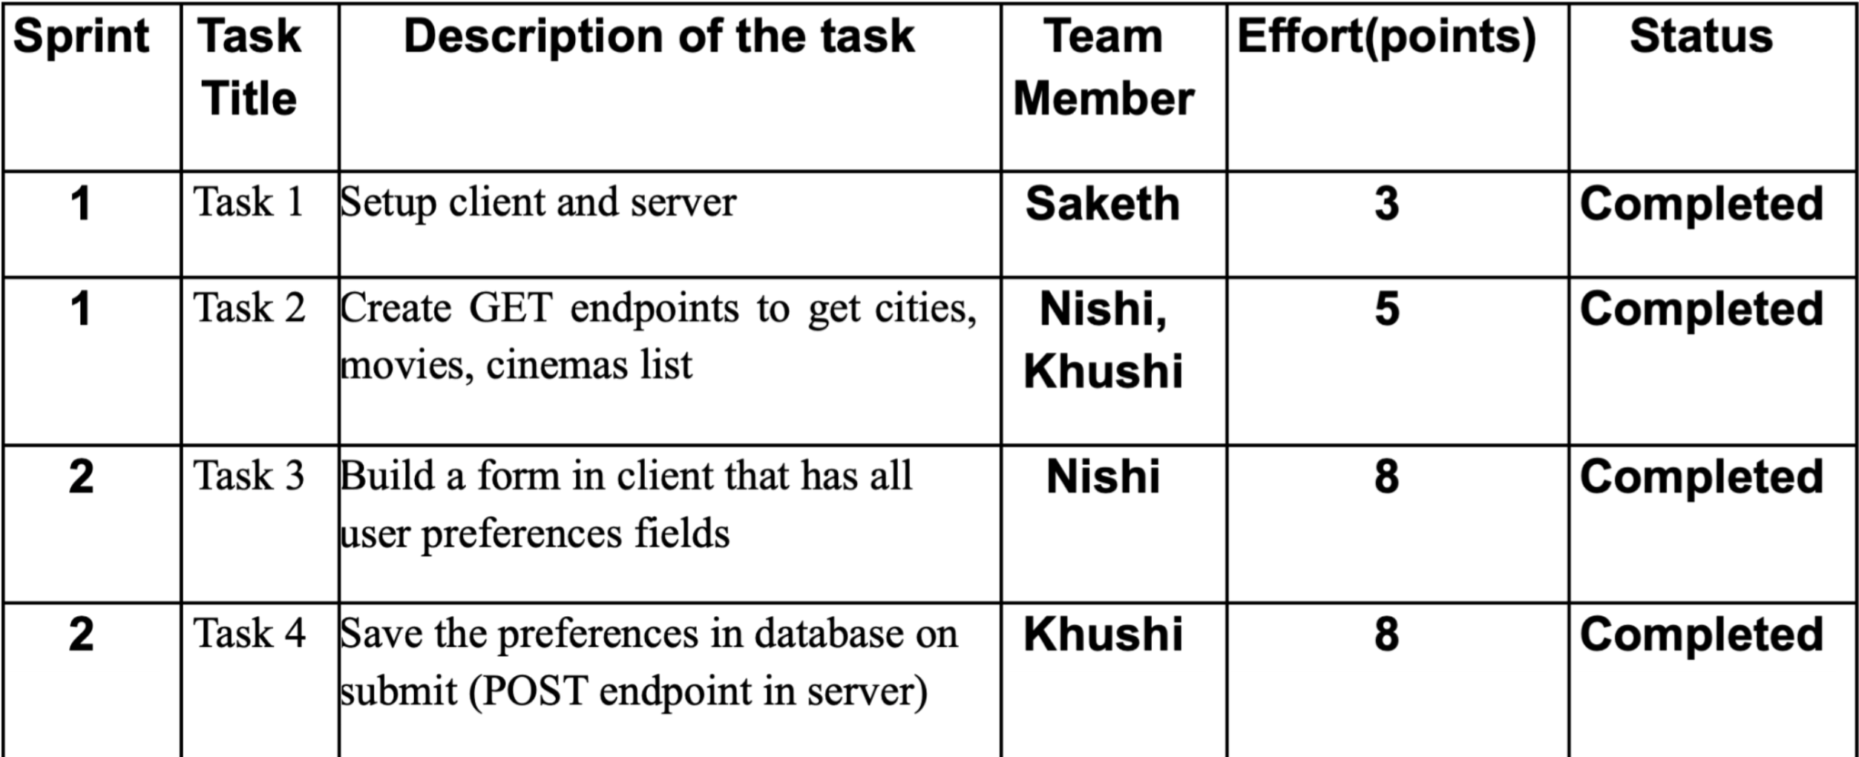
Sprint Backlog

Slide 13
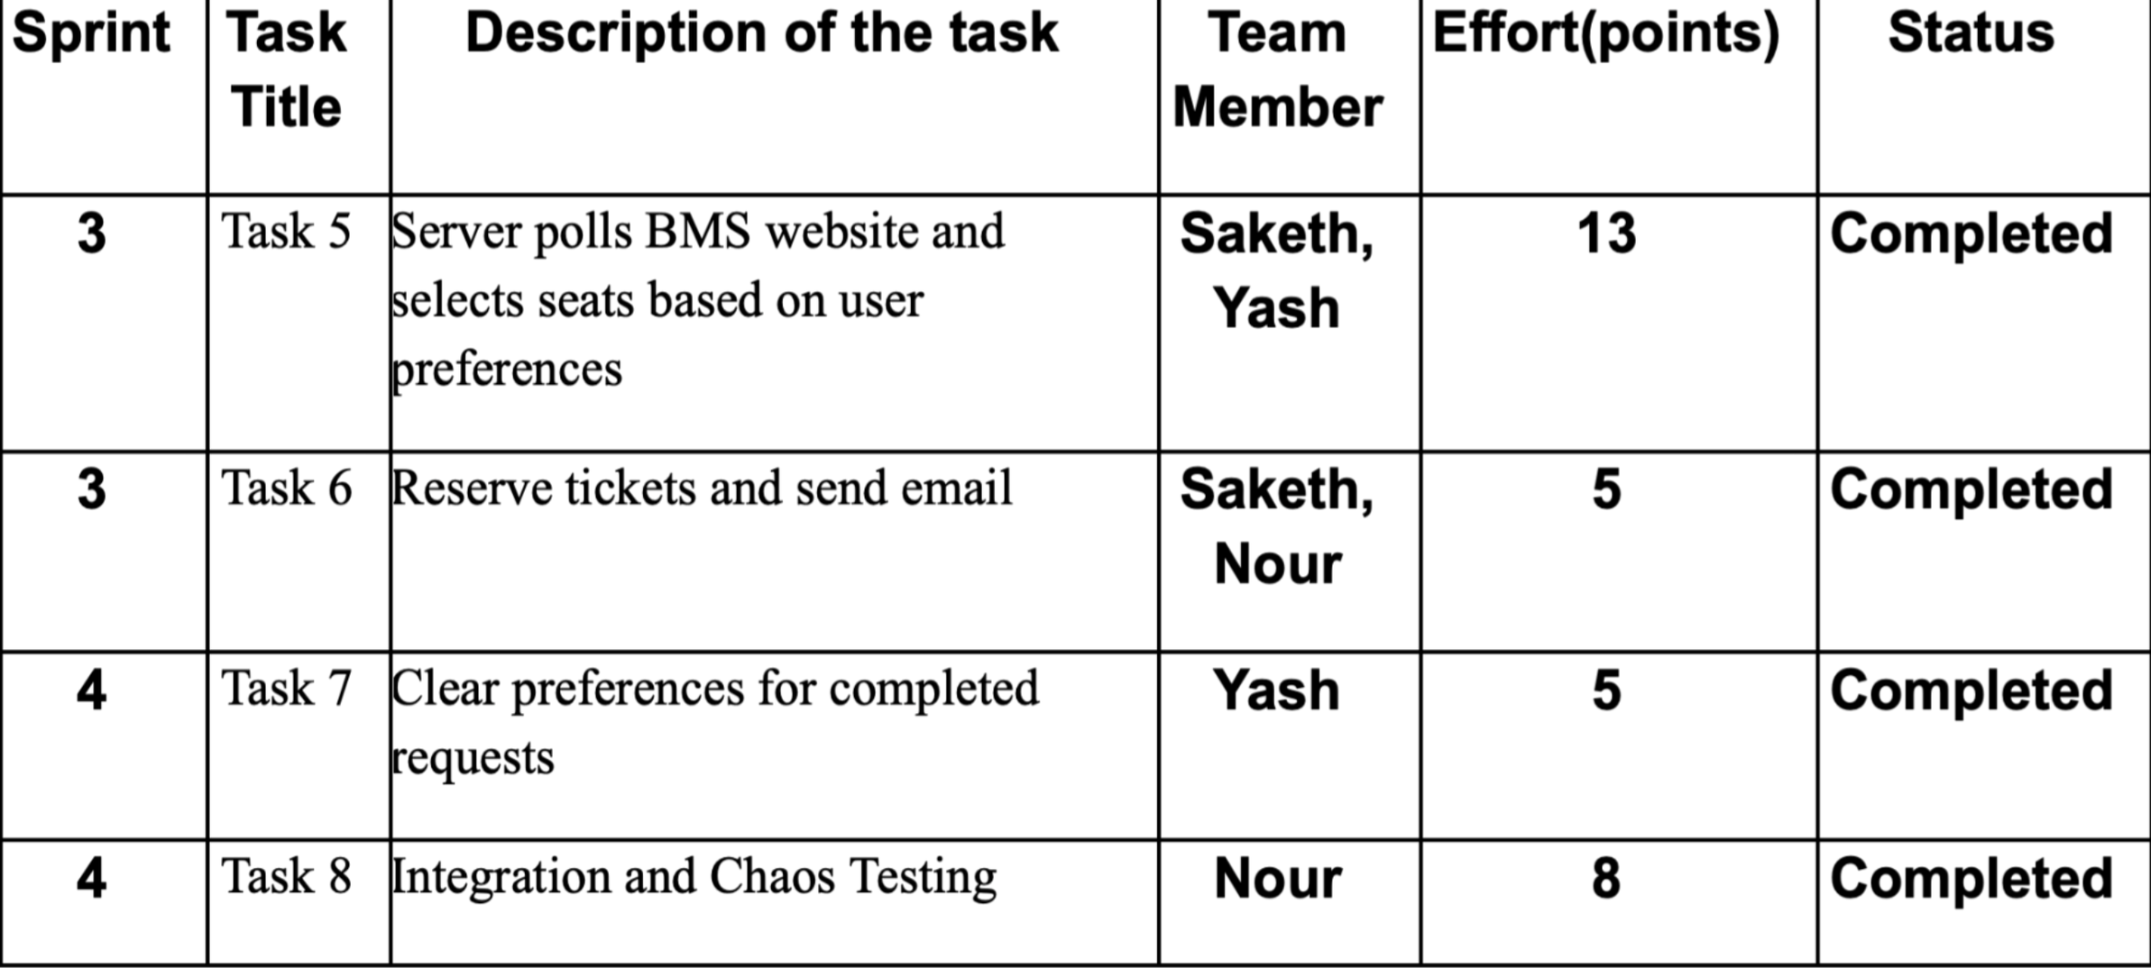
Sprint Backlog

Slide 14







Technologies Used

Slide 15
Lessons Learned
Allowing user customizations
The project emphasized the significance of allowing users to specify their seating preferences and movie details, tailoring solutions to meet user needs effectively.
Iterative development
Conducting user testing and gathering feedback was essential for refining the system and improving usability, underscoring the importance of an iterative approach driven by user feedback.
Collaboration
Working with team members where tasks were evenly distributed, fostering effective collaboration.
Well-defined requirements
How well-defined user stories contributed to a better understanding of requirements, ensuring accurate implementation.
Stakeholder engagement
Gathering feedback from stakeholders and end-users was crucial for aligning the solution with their needs and expectations.

Slide 16




Future Scope
Managing multiple users selecting same preferences
Offer different subscription tiers with varying benefits
Implement a robust synchronization mechanism to handle concurrent bookings for the same movie and seating preferences, ensuring fairness and avoiding conflicts.
Introduce tiered subscription plans with basic, premium, and exclusive options, offering varying levels of access, discounts, and additional perks such as priority booking or unlimited screenings.
Enhance notification system with personalized alerts
Implement personalized recommendations
Leverage user preferences and booking history to send targeted notifications about upcoming movie releases, seat upgrades, or special promotions, using email, push notifications, or SMS.
Utilize user data, including booking history and preferences, to provide tailored movie, seating, and showtime recommendations, enhancing the overall user experience and increasing engagement.
By addressing these future scope items, MovieMate can continue to evolve and provide an exceptional automated movie ticket booking experience, catering to diverse user needs and preferences.

Slide 17
Live Demo for MovieMate Application

Slide 18
Github Repo Link:
https://github.com/ypatil11/ITCS6112_MDSP24_Group6

Slide 19
Thank you

